Slide 1

WEB Development
Grade 7&8

Slide 2
Recap of the last Class
Notes:
Objective:
Learned how to implement images and style the gallery:
Summary Day 1:
Web Page Structure:
DOCTYPE, HTML, Head, and Body elements.
Metadata and external resources.
Header and Navigation:
Created a header with a title and navigation links.
Gallery Section:
Added images using <div> and <img> tags.
Styled the gallery with CSS.
CSS Styling:
Reset default styles.
Used Flexbox for layout and added hover effects.

Slide 3
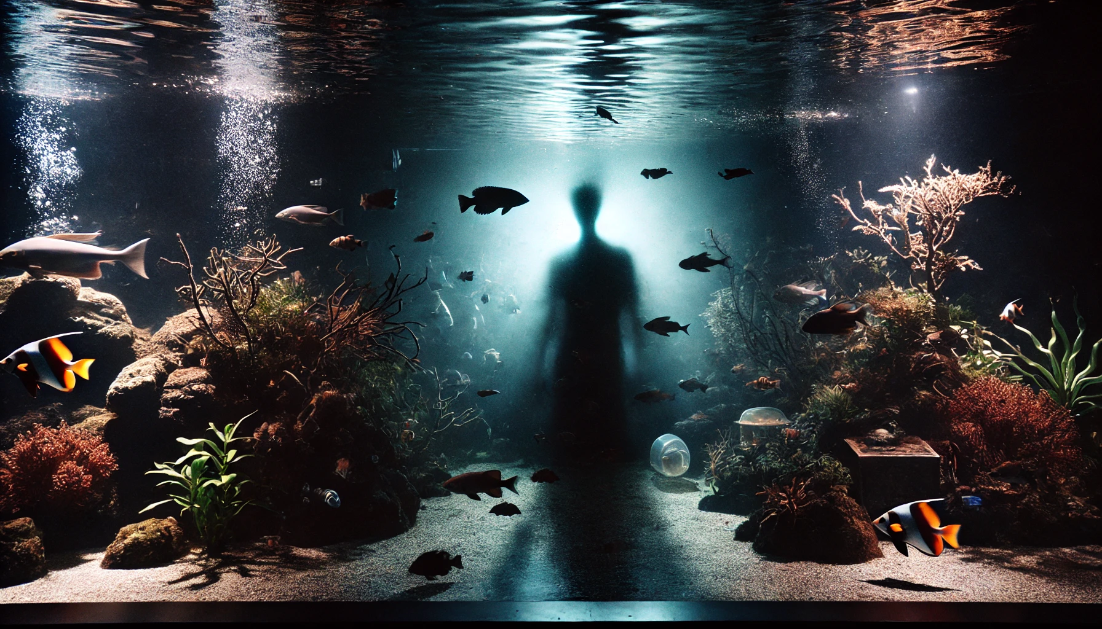
The Mysterious Shadow
"Last night, the aquarium staff noticed something unusual: a mysterious shadow moving through the water in several tanks. The night guard, Ms. Wave, is convinced there's more to the story. She needs your help to solve the riddle and uncover the truth. Here is the riddle:
When darkness falls in the deep blue sea,
A shadow moves mysteriously,
Not a fish, nor a plant, nor a piece of coral,
What could this be that seems paranormal?
What could this shadow be that appears at night? Use your knowledge of marine life and aquarium systems to solve the riddle and help Ms. Wave discover the source of the mysterious shadow."
Notes:
Answer:
The answer to the riddle is "nocturnal fish." Some fish are more active at night and can cast shadows that appear mysterious to observers. Ms. Wave learns that understanding the behavior patterns of different species, including nocturnal activities, is essential for interpreting what happens in the aquarium after dark.

Slide 4
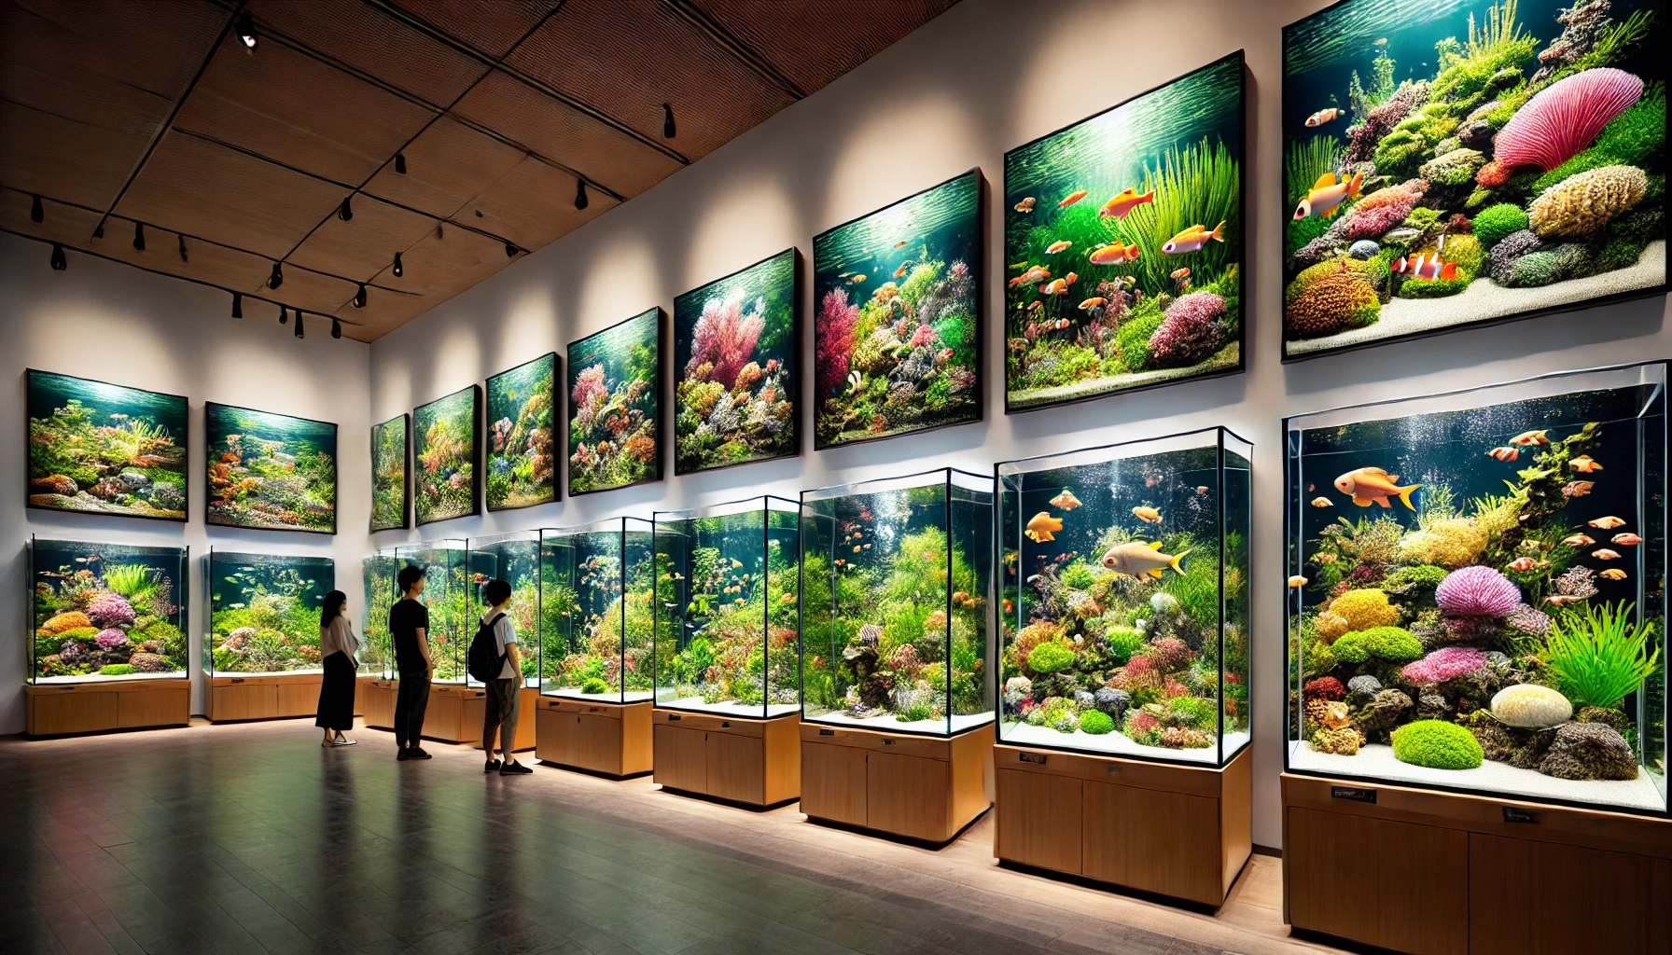
Implementation of Videos and Iframes
Notes:
Objective:
Introduce the concept of Images, videos, iframes.
Day 1: Objective
Objective:
Implement and style videos and iframes to enhance the web page.
Understand the role of multimedia elements in creating an engaging user experience.
Solve a marine life-related mystery using observational and analytical skills through an interactive riddle.

Slide 5
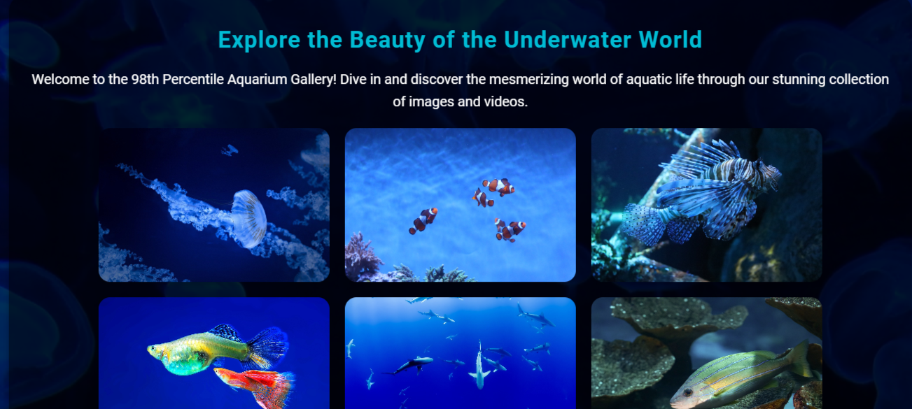
Project – 98th Percentile Aquarium Gallery
Notes:
Project Link: Aquarium Gallery
Objective:
Present the final project example.
Teacher Instructions:
Show the Screenshot:
Display the screenshot of the final project example.
Show the Project in Live Action:
Demonstrate the project on a live website to show how it functions.
Navigate through the website to showcase the images, iframes, videos in background Showcase Animation hover.
Emphasize the importance of marine life and how to protect them.
Explain the Project:
Inform students that they will create a similar project.
Highlight the key features:
A clear and user-friendly Image Gallery.
An engaging webpage using animation.

Slide 6
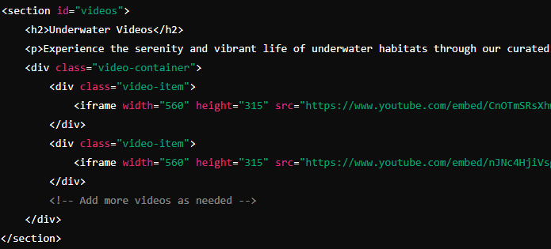
Videos Section with Iframes
Notes:
"Teacher's Activity"
Project Link: Aquarium Gallery
Objective:
Understand how to add YouTube video using embedded iframes
Teacher Instructions:
Display the screenshot of the HTML code.
Provide an overview of the videos section:
Code Explanation:
<section>: Defines a section of the webpage with the id "videos."
<h2>: Subheading for the videos section.
<p>: Paragraph describing the videos section.
<div class="video-container">: Container for the video items.
<div class="video-item">: Each video item containing an iframe.
<iframe>: Inline frame to embed YouTube videos, with attributes for width, height, source URL, and other settings.

Slide 7
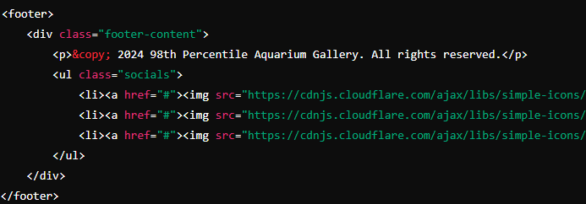
Footer Section
Notes:
"Teacher's Activity"
Project Link: Aquarium Gallery
Objective:
Understand how to add icons using Cloudflare or font awesome CDN
Teacher Instructions:
Display the screenshot of the HTML code.
Provide an overview of the footer section:
Code Explanation:
<footer>: Defines the footer section of the webpage.
<div class="footer-content">: Container for footer content.
<p>: Paragraph for copyright information.
<ul class="socials">: Unordered list for social media links.
<li>: List item for each social media link.
<a>: Anchor tag for social media links.
<img>: Image tag for social media icons.
Icons:
Facebook: https://cdnjs.cloudflare.com/ajax/libs/simple-icons/3.0.1/facebook.svg
Twitter or x: https://cdnjs.cloudflare.com/ajax/libs/simple-icons/3.0.1/twitter.svg
Instagram: https://cdnjs.cloudflare.com/ajax/libs/simple-icons/3.0.1/instagram.svg
CDJNS:
Explore the web page: https://cdnjs.com/libraries

Slide 8
Html Structure Done
Let's Style it Now
Notes:
Objective:
Review the code till now
Project Link: Aquarium Gallery
Teacher Instructions:
Recap the key points.
Encourage interactive discussion and exploration of html code.

Slide 9
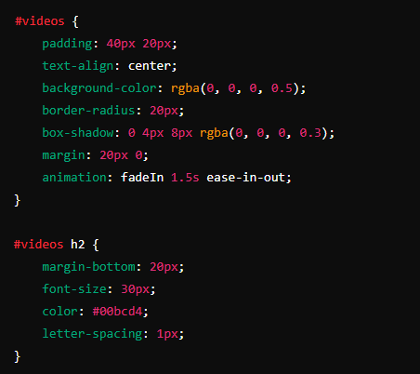
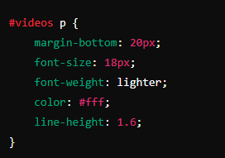
CSS Styling for Videos and Iframes
Notes:
"Teacher's Activity"
Project Link: Aquarium Gallery
Objective:
Understand how to add animation to videos making them responsive to hover
Teacher Instructions:
Display the screenshot of the CSS code.
Provide an overview of animation and how it improve responsiveness of a web page and make it more engaging
Code Explanation:
#videos: Style the videos section with padding, center alignment, background color, border radius, shadow, margin, and fade-in animation.
#videos h2: Style the subheading with margin, font size, color, and letter spacing.
#videos p: Style the paragraph with margin, font size, lighter weight, color, and line height.

Slide 10
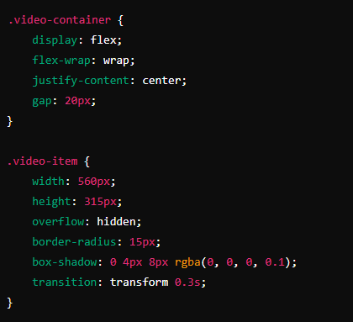
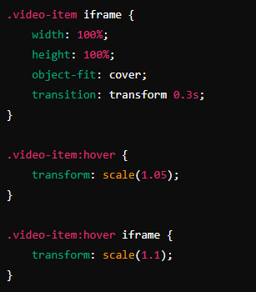
CSS Styling for Videos and Iframes
Notes:
"Teacher's Activity"
Project Link: Aquarium Gallery
Objective:
Understand how to add hover Sudo class for hover effect using flex box to make the video section responsive to screen sizes
Teacher Instructions:
Display the screenshot of the CSS code.
Provide an overview of flex box and hover sudo class
Code Explanation:
.video-container: Style the container to use flexbox for layout, wrapping items, centering them, and adding spacing.
.video-item: Style each video item with width, height, hidden overflow, border radius, shadow, and transition effect.
.video-item iframe: Style the iframes to cover the entire video item, with transition effect.
.video-item:hover: Add hover effect to scale up the video item.
.video-item:hover iframe: Add hover effect to scale up the iframe inside the video item.

Slide 11
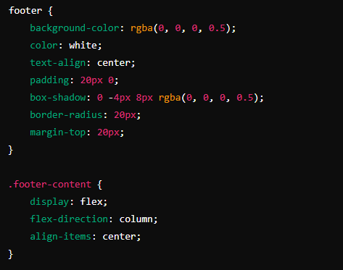
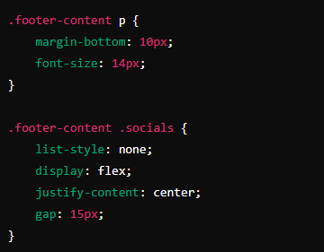
CSS Styling for Footer
Notes:
"Teacher's Activity"
Project Link: Aquarium Gallery
Objective:
Understand how to add hover Sudo class for hover effect using flex box to make the footer section responsive to screen sizes
Styling the social icons
Teacher Instructions:
Display the screenshot of the CSS code.
Provide an overview of flex box and hover sudo class
Code Explanation:
footer: Style the footer with background color, text color, center alignment, padding, shadow, border radius, and margin.
.footer-content: Style the footer content container with flexbox for layout, centering items.
.footer-content p: Style the paragraph with margin and font size.
.footer-content .socials: Style the unordered list for social media links, centering them and adding spacing.

Slide 12
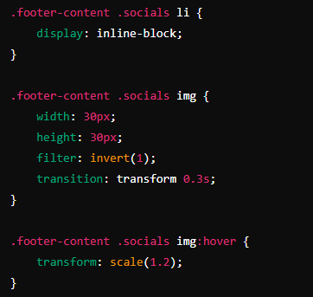
CSS Styling for Footer
Notes:
"Teacher's Activity"
Project Link: Aquarium Gallery
Objective:
Understand how to add hover Sudo class for hover effect using flex box to make the footer section responsive to screen sizes
Styling the social icons
Teacher Instructions:
Display the screenshot of the CSS code.
Provide an overview of flex box and hover sudo class
Code Explanation:
.footer-content .socials li: Style the list items for social media links.
.footer-content .socials img: Style the social media icons with size, filter, and transition effect.
.footer-content .socials img:hover: Add hover effect to scale up the social media icons.

Slide 13
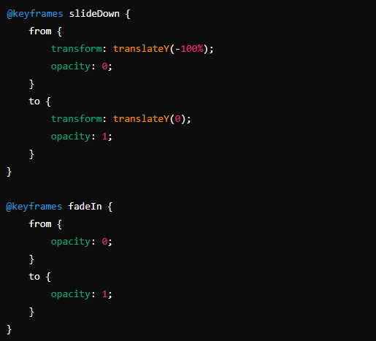
CSS Keyframes for animation
Notes:
"Teacher's Activity"
Project Link: Aquarium Gallery
Objective:
Understand how to use keyframes effectively
Teacher Instructions:
Display the screenshot of the CSS code.
Provide an overview how keyframes work.
Code Explanation:
@keyframes slideDown: Defines an animation for sliding down with opacity transition.
@keyframes fadeIn: Defines an animation for fading in with opacity transition.

Slide 14
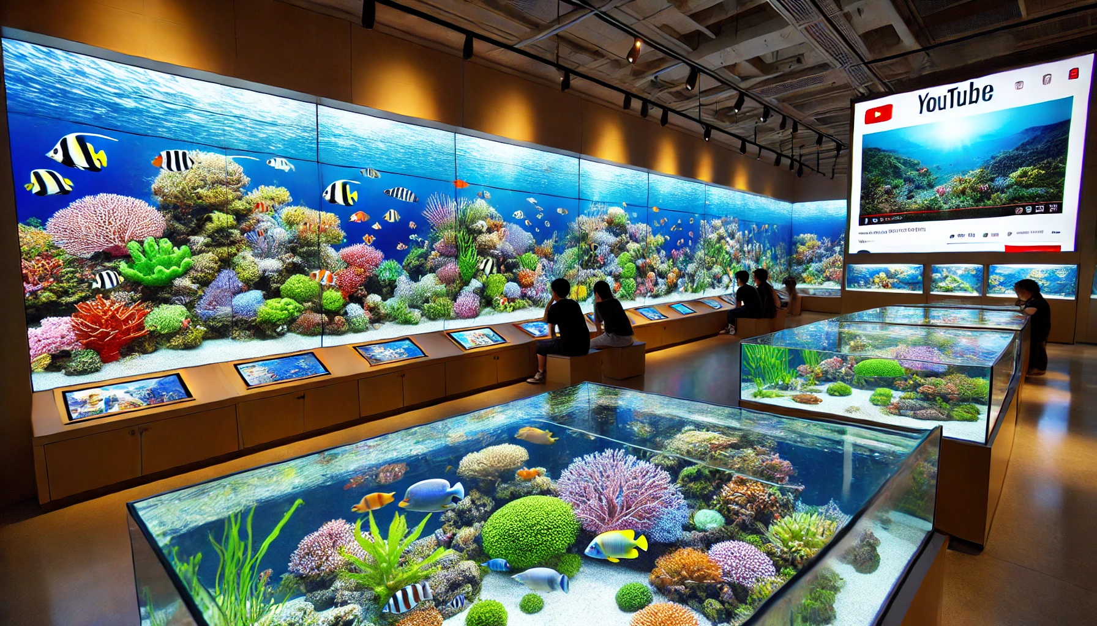
Now it's your turn!
Task:
Find Additional Videos:
Search for underwater or aquarium-themed videos on YouTube.
Copy the embed URLs of the selected videos.
Update HTML:
Add the new videos to the video container in your HTML file.
Instructions: Share the code with others and work as a group to give your own personalization to the final web page.
Notes:
"Students' Activity"
Objective:
Allow students to use their creativity in designing the aquarium video gallery
Teacher Instructions:
Guide students on how to search for and embed YouTube videos.
Show them how to update the HTML to include new videos.
Emphasize maintaining consistent styling for a cohesive look.

Slide 15

How to Save & Share the project.
Replit offers autosave option – so not worry about the same.
To share project with someone in view mode: just copy the link from the URL bar, and share the link
To share the project for collaboration
Click on "Invite" from the top right corner
If you know the username, type it in the box and click on invite
You can also turn on the toggle button "private join link" to create a public collaboration link and invite members to edit your code.
Notes:
Instructions for the Teacher:
Explain how to save and share projects on Replit, including the options for collaboration.
Emphasize the importance of sharing projects for feedback and collaboration.

Slide 16

Question: What HTML element is used to embed a YouTube video on a web page?
a) <video>
b) <embed>
c) <iframe>
d) <object>
Notes:
Answer: c) <iframe>

Slide 17
Question: Which CSS property is used to add space between flex items in a container?
a) margin
b) padding
c) gap
d) border
Notes:
Answer: c) gap

Slide 18
Question: Which attribute in the <iframe> tag allows the video to play in full screen mode?
a) fullscreen
b) allowfullscreen
c) allow-screen
d) full-screen
Notes:
Answer: b) allowfullscreen

Slide 19
Question: What CSS property is used to add a shadow effect to elements?
a) box-shadow
b) text-shadow
c) border-shadow
d) element-shadow
Notes:
Answer: a) box-shadow

Slide 20

Videos Section:
Added a new section for embedding YouTube videos.
Used <iframe> tags to embed videos.
HTML Structure:
Created a container for video items within the videos section.
CSS Styling:
Styled the videos section with padding, background color, border radius, and shadow.
Applied Flexbox to the video container for layout.
Added hover effects to video items.
What have we learnt?
Notes:
Objective:
Summarize the key learnings from the lesson.
Teacher Instructions:
Instruct Student's to recap Today's Learning
Keep a healthy discussion engage student to a group discussion
Show a glimpse of what is awaiting to be reveal on the next class

Slide 21

Homework Discussion
Notes:
Instructions for the Teacher: Facilitate a discussion about the homework assignment.

Slide 22

Be Skeptical of Promises
If something online sounds too good to be true, like 'free games for life,' it could be a trick.
Oliver saw an ad online promising "free games for life" and eagerly clicked on it, hoping for a great deal.
Instead, his computer got infected with malware, causing a lot of problems.
The moral of the story: don't believe ads or emails promising free stuff without checking with an adult first, as it could be a trick.

